Slide 1
SoCal Microsoft Technology User Group
User Group Meeting 2013-05-06 – Thomas Stensitzki
Notes:
1

Slide 2

Introduction
Thomas Stensitzki
Senior Consultant, iCOMcept GmbH
MCM, MCSE, MCSA, MCITP, MCTS, MCSA, MCSA:M, MCP
Blog: http://www.sf-tools.net Email: thomas@sf-tools.net Twitter: apoc70
Notes:
A little history of Microsoft Learning titles and abbreviations
LinkedIn and other social media connections on homepage

Slide 3
Agenda
Exchange 2013 Architecture
Overview
CAS / MBX 2013
Transport Architecture
Service Availability
Exchange and Office 365 – Going Hybrid
Why are organizations going hybrid?
What are the benefits and risks?
How do we go hybrid?
On-Premise requirements for hybrid or cut-over
Notes:
Who runs Exchange 2013 already?
Who maintains an Exchange 2010 environment?
Mixed with Exchange 2007?
Mixed with Exchange 2003?
Who maintains even Exchange older than 2003?
Anybody who already deployed an hybrid configuration or migrated to Office 365?

Slide 4
Agenda
Exchange Server 2013
New Exchange Architecture
Client Access Server 2013
Mailbox Server 2013
Transport Architecture
Service Availability
Exchange and Office 365 – Hybrid
What is it good for?
Migration scenarios
Hybrid deployment
Migrations interfaces
Notes:
Who runs Exchange 2013 already?
Who maintains an Exchange 2010 environment?
Mixed with Exchange 2007?
Mixed with Exchange 2003?
Who maintains even Exchange older than 2003?
Anybody who already deployed an hybrid configuration or migrated to Office 365?

Slide 5
Agenda
Exchange Server 2013
New Exchange Architecture
Client Access Server 2013
Mailbox Server 2013
Transport Architecture
Service Availability
Exchange and Office 365 – Hybrid
What is it good for?
Migration scenarios
Hybrid deployment
Migrations interfaces

Slide 6










Exchange 2007/2010 Server Role Architecture
5 major roles
Tightly coupled
Functionality
Geo affinity
Versioning
User partitioning
Enterprise Network
Phone system (PBX or VOIP)
Forefront
Online Protection for Exchange
Edge Transport
Routing and AV/AS
Hub Transport
Routing & policy
Mailbox
Storage of mailbox items
Unified Messaging
Voice mail and
voice access
External
SMTP servers
Mobile
phone
Layer 7 LB
Client Access
Client connectivity
Web services
Web
browser
Line of
business
application
Outlook
(remote user)
Outlook (local user)
AD
Notes:
Why Change?: Doing Exchange load balancing “right” is hard and often require expensive solutions
Some of the issues with the 5 core server roles is that they are tightly coupled. In E2007 when we developed the server roles, our goal was to have them be autonomous units – admin management, etc. It turns out it never quite materialized – either in engineering or customer deployment. What we have learned is in practice these roles get tightly coupled. They are coupled functionality – scattered across Mailbox, CAS, and Transport. Can’t get new functionality by upgrading a single role – have to upgrade them all. The other way they are coupled has to do with geo-affinity. The middle tier roles (HT, CAS) talk to MBX via RPC in a chatty manner that only works well if they are located within a well connected network. Coming back to versioning – each release is version constrained – E2007 servers don’t talk to E2010 servers. From a user partitioning perspective, the same set of users that are being served by a given MBX are also served by a given set of CAS and HT.
So in summary, even though we have 5 server roles, we would deploy them a single monolithic entity.

Slide 7
Anything wrong with the existing model?
Exchange load balancing not easy to configure
LB session affinity impacts scalability
Hardeware LB solutions tend to be expensive and therefore are a luxury to many Exchange customers
Deployment based on dedicated server roles
Hardware stays unutilized or under-utilized
Real multi-role deployments are rare
Too many namespaces (especially in site resilient designs)
Exchange deployments are overly complicated

Slide 8

The Exchange Evolution
2000/2003
2007
2010
2013
Role differentiation through manual configuration
Hardware solutions for “reliability” ($$$$)
Separate roles for ease of deployment and mgmt. segmentation
Support cheaper storage
Separate HA solutions for each role
Introduced the DAG
Rich management experience using RBAC
Leaves resources on the ground in each role
Simplify for scale, balanced utilization, isolation
Integrate HA for all roles
Simplify network architecture
LB
Ex
Ex
CAS
HT
L7 LB
SAN
Ex
Ex
MBX
MBX

Slide 9

Exchange 2013 Architecture
2 Building Blocks
Client Access Array
Database Availability Group
Loosely coupled
Enterprise Network
Forefront
Online Protection for Exchange
AD
Forefront
Online Protection for Exchange
Edge Transport
Routing and AV/AS
CAS Array
DAG
CAS
MBX
CAS
MBX
Layer 4 LB
External
SMTP servers
CAS
MBX
CAS
MBX
CAS
MBX
Mobile
phone
Web
browser
Line of
business
application
Outlook
(remote user)
Phone system (PBX or VOIP)
Outlook (local user)
Notes:
Decrease TCO for on-premise customers by supporting all load balancers, even WNLB & DNS RR) => redundant client access at a much lower cost
Two buldings blocks in Exchange 2013: Front-End and Back-End. (Someone remembers those terms?)
The two roles are loosely coupled. Functionality should not be cut across CAS 2013 and MBX 2013. Both should be independenty upgradable and should allow cross-version interaction.
There is no expectation that CAS reside in the same location as MBX, especially for large enterprises.

Slide 10
Cross Server Access
EWS protocol
MRS proxy protocol
SMTP
EWS
MRS MRSProxy
Transport
Custom WS
Transport
MRS MRSProxy
EWS
Protocols,
Server Agents
RPC CA
Assistants
Assistants
RPC CA
XSO
Mail Item
XSO
Mail Item
Banned
Business Logic
E2010
CTS
Other API
CTS
Other API
Store
Content index
Store
Content index
Storage
ESE
File system
ESE
File system
Server A
Server B
Notes:
Protocols are always served from the protocol instance that is local to the active database copy for a given mailbox
“Every Server is an Island”
RPC CA: RPC Client Access

Slide 11
Changing Functional Layers
Exchange 2010 Architecture
Exchange 2013 Architecture
Hardware LB
L7 Load Balancer
L4 Load Balancer
CAS 2013
AuthN, Proxy, Re-direct
AuthN, Proxy, Re-direct
CAS, HT, UM
Protocols, API, Biz-logic
Assistants, Store, CI
Protocols, API, Biz-logic
MBX
Store, CI
MBX 2013
Notes:
Functional layers for Exchange 2010 on the left and Exchange 2013 on the right.
Top down we start with the network and load balancers. Second we have CAS and HAT arrays (aka the middle tier). The two seperate layers in the middle tier (authorization/Proxy/redirection) and protocol implementation and the handling of the data were the root for certain problems. The bottom part of CAS/HAT is tied to the mailbox which is the reason to have those co-located. Hence we now have two components: One client facing (CAS) and one data processing (MBX) component.
Client facing componts from 2010 moved to CAS 2013 and protocol handling from CAS and HAT to MBX 2013.
CAS aka Front-End and MBX aka Back-End

Slide 12




Putting it all together
User
CAS
DAG1
MBX-B
MBX-A
MBX-B
MBX-A
Notes:
With the two server roles in Exchange 2013 the CAS authenticates and proxies users to the MBX the hosting the ACTIVE copy of the database in which the mailbox resides. User NO LONGER connect to MBX directly, not even for Public Folders.
Protocols aare always served from the protocal instance local to the active database copy..
All data connectivity, data rendering and mail flow for a given user is always handled by the server hosting the user‘s active mailbox copy. In the event of a failure the processing switches to the activating server.
This means fundamental change for the internal Exchange monitoring components. The components are now tightly integrated and cannot be seen as separate components. If a single component with in the server is unresponsive, the suers is going to have connectivity or mail flow issues.

Slide 13
Agenda
Exchange Server 2013
New Exchange Architectur
Client Access Server 2013
Mailbox Server 2013
Transport Architecture
Service Availability
Exchange and Office 365 – Hybrid
What is it good for?
Migration scenarios
Hybrid deployment
Migrations interfaces

Slide 14
What is CAS 2013?
CAS 2013 is comprised of three components:
Client protocols (HTTP, IMAP, POP)
SMTP
UM Call Router
Thin, stateless (protocol session) servers organized in a load balanced configuration
Session affinity NOT required at the load balancer
Provides a unified namespace and authentication for clients
Where the logic “lives” to route a specific protocol request to the “correct” destination end point
Capable of supporting legacy servers with redirect or proxy logic
Is a domain-joined machine in the corporate forest
Notes:
CAS can be seen as a number of thin servers who are stateless from a protocal session perspective.
CAS 2013 does NOT require session affinity and therefore not Layer 7 LB. CAS itself handls session affinity. We still need load balancers to handle connection management policies (e.g. round-robin, least connection, etc.)
This approach gives more flexibility with respect to LB. It increases capabilities/utilization of the LB as no SSL processing, session cookie processing, etc. occurs on the LB.

Slide 15








CAS 2013 Client Protocol Architecture
OWA
Outlook
EAS
EAC
PowerShell
IMAP
SMTP
Telephony
SIP + RTP
Load Balancer
Redirect
IIS
POP
IMAP
SMTP
UM
CAS 2013
HTTP Proxy
HTTP
POP
IMAP
SMTP
IIS
POP
IMAP
Transport
UM
MBX2013
RPS
RpcProxy
OWA, EAS, EWS, ECP, OAB
MDB
MailQ
RPC CA
Notes:
Haven’t we talked about CAS being THE endpoint for client connectivity? Well, there is one excpetion.
CAS 2013 does not proxy SIP/RTP. It always re-directs the call to appropriate UM server.

Slide 16
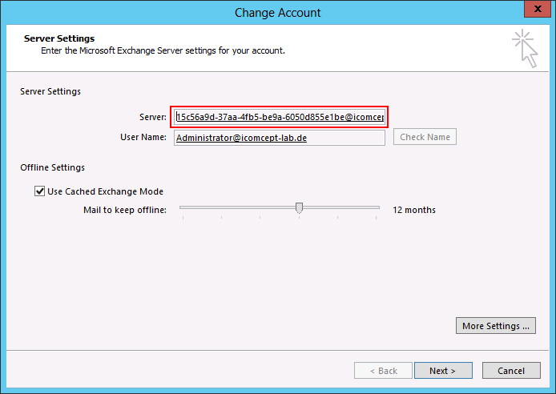
Outlook Connectivity
What are the benefits?
Does not require a “RPC CAS array namespace” for the DAG
No longer have to worry about “The Exchange administrator has made a change that requires you to quit and restart Outlook” during mailbox moves or *over events
Extremely reliable and stable connectivity model – the RPC session is always on the MBX 2013 server hosting the active database copy
What changes?
RPC end point for Outlook client is now a GUID (and SMTP suffix)
Support for internal and external Outlook Anywhere namespaces
Notes:
RPC/HTTP removes the need for a complicated namespace for the DAG (RPC Client Access service) and simplifies the protocol stack
How does it work?
- CAS 2013 receives outer HTTP request, directed to mail.contoso.com
- CAS 2013 extracts RPC Server Name from the request URL, which is in the form of mailbox-guid@contoso.com
- CAS 2013 performs an AD lookup of the mailbox GUID, followed by an Active Manager lookup, and determines which MBX2013 server the active database copy is hosted on
- CAS 2013 proxies the HTTP request to the MBX2013
So few things to keep in the back of your mind:
Remember CAS2013 is an authentication and proxy/redirection server. It does no processing of the data (no rendering or transformation). It simply proxies the request to MBX2013 using the client protocol. In this case HTTPS.
CAS2013 and MBX2013 are not tied together from a user affinity or geographical perspective. You can have CAS2013 in one datacenter authenticate the request and proxy the request to a MBX2013 server in another datacenter. To enable this we had to change the communication protocols used between server roles. Moving away from RPC to protocols that are more tolerant of WAN/Internet connectivity/throughput/latency.
For a given mailbox, the protocol that services the request is always going to be the protocol instance on the server that hosts the active copy of the database for the user’s mailbox. This was done to ultimately uncouple versioning and functionality issues we’ve seen in the past two generations (i.e., have to deploy CAS2010, HT2010, MBX2010 together to get certain functionality and upgrading one doesn’t necessarily give you new capabilities and may break connectivity).
This last bullet is tied to this discussion. In all prior releases the RPC endpoint was a FQDN. In fact the shift to the middle tier for RPC processing in CAS2010 introduced a new shared namespace, the RPC Client Access namespace. By moving RPC Client Access back to the MBX2013 role, this would have forced us to use either a) use MBX2013 FQDN the RPC endpoint (thus forcing an Outlook client restart for every db *over event) or b) use a shared namespace for the DAG. Neither option is appropriate and adds to the complexity and support of the infrastructure. So instead, we changed the model. We no longer use a FQDN for the RPC endpoint. Instead we now use a GUID. The mailbox GUID, to be precise (and a tenant domain to support multi-tenant scenarios). The mailbox GUID is unique within the (tenant) organization, so regardless of where the database is activated and mounted, CAS can discover the location and proxy the request to the correct MBX2013 server.
In the end, this means that we have a very reliable connection model – for a given session that is routed to CAS2013, CAS2013 will always have a 1:1 relationship with the MBX2013 server hosting the user’s mailbox. IN the event a *over occurs, CAS2013 will proxy the connection to MBX2013 that is now hosting the active database copy. Oh and this means in a native E2013 environment, Outlook won’t require a restart for things like mailbox moves, *over events, etc.
-----
Why did people in previous versions get the “The Exchange administrator has made a change that requires you quit and restart Outlook” dialog?
To understand this behavior, it's helpful to understand what generates the dialog in Outlook and why Exchange 2010 triggers the message. Outlook caches three items about each Exchange mailbox it opens and it requests a restart if any of them change:
MappingSignature - This is a combination of the named property mapping for the mailbox and the REPLID/REPLID-GUID for the mailbox.
ServerName - in Exchange 2010, this corresponds to the value of the RPCClientAccessServer property on the database containing the mailbox.
RootFID - the root folder ID of the mailbox.
In E2010 SP1, you would see that dialog if:
You do not preserve the mailbox signature (named property quota exhaustion)
RPCClientAccessServer property changes
PF store server failure (MAPI endpoint changes due to hierarchy store change)
Why GUID for RPC server name -> it’s the only unique value that corresponds to the mailbox.
====
Both RPCCA and AB now return the mailbox GUID when clients request either the mailbox server or attempt to get the legacyExchangeDN of the MDB or server.
Autodiscover returns the mailbox GUID@tenant format instead of the AD value for Server, ServerDN, and MDBDN attributes.
When an RPC/HTTP requests comes to CAS2013, Exchange needs to redirect it to the proper back-end. To determine which backend to redirect the request to, Exchange will use the RPC target specified in the RPC/HTTP query string. This will contain the Mailbox GUID which can be used to look up the user.

Slide 17
Third-Party MAPI Products
Third-party MAPI products will need to use RPC/HTTP to connect to CAS2013
Exchange 2013 will be the last release that supports a MAPI/CDO download
Third-parties must move to EWS in the future
The MAPI/CDO download will be updated to include support for RPC/HTTP connectivity
Will require third-party application configuration; either by programmatically editing a dynamic MAPI profile or setting registry keys
Legacy environments can continue to use RPC/TCP
Notes:
Last bullet point: Requires a legacy environment on premise

Slide 18


Client Protocol Connectivity Flow
HTTP
HTTP
HTTP
Load Balancer
Load Balancer
CAS
CAS
IIS
IIS
HTTP
HTTP Proxy
Site Boundary
HTTP Proxy
Site Boundary
HTTP
HTTP
MBX
MBX
MBX
Protocol Head
Protocol Head
Protocol Head
DB
DB
DB
Local Proxy Request
OWA Cross-Site Redirect Request
Cross-Site Proxy Request
Notes:
Scenario 1 – local request
Scenario 2 – redirect request
Scenario 3 – proxy request
Default behavior x-cross site will be proxy.
Scenario 3 – I show the site without a CAS2013 array, but a CAS2013 array could be there – the point is when we proxy it is always from CAS 2013 to MBX 2013.

Slide 19
Exchange Load Balancing Options
Generalist IT admin
Those with increased network flexibility
Those who want to maximize server availability
Who’s it for?
Functionality
Simplicity
+ Simple, fast, no affinity LB
+ Single, unified namespace
+ Minimal networking skillset
- Per Server Availability
+ Simple, fast, no affinity LB
+ Per protocol availability
- One namespace per protocol
+ Per protocol availability
+ Single, unified namespace
- SSL termination @ LB
- Requires increase networking skillset
Trade-Offs
Notes:
Per Server Availability - Requires admin to chose a canary protocol
One namespace per protocol - Or fewer namespaces if grouped based on priority (each group would contain a P1 protocol with some P2 protocols) or scenario (i.e protocols needed by Outlook)
SSL termination @ LB - No cookie inspection, no affinity persistence. RTM would require re-encryption to CAS until SSL offloading is supported

Slide 20
Client Protocol Benefits
Simplifies the network layer
No longer requires session affinity at the load balancer
Just get the traffic to CAS 2013 and let it handle the affinity
CAS 2013 can be “farther away” from MBX2013 and still offer good client performance (because it is a 1:1 proxy)
Removes the need for RPC Client Access arrays
Deployment flexibility
CAS 2013 provides more deployment flexibility; for example, consolidate to fewer sites
Can deploy a single world-wide namespace
Simplifies upgrade and inter-op
Designed to proxy to multiple Mailbox server versions, up and down level
DAGs can be replaced with Exchange 2013 at any desired pace
Notes:
1:1 proxy refers to a 1:1 protocol relationship between CAS and MBX

Slide 21
Agenda
Exchange Server 2013
New Exchange Architectur
Client Access Server 2013
Mailbox Server 2013
Transport Architecture
Service Availability
Exchange and Office 365 – Hybrid
What is it good for?
Migration scenarios
Hybrid deployment
Migrations interfaces

Slide 22
Mailbox Server Role
A server that hosts all the components that process, render and store the data
Clients do not connect directly to MBX2013 servers; connectivity is through CAS2013
Evolution of E2010 DAG
Collection of servers that form a HA unit
Databases are replicated between servers in a given DAG
Servers can be in different locations, for site resiliency
Maximum of 16 Mailbox servers
50 database copies / server
MBX1
MBX2
MBX16
Notes:
The only difference between E2010 and E2013 is that CAS, HT, and UM are included in the MBX 2013 server. Then you organize the servers in a familiar DAG configuration. The key is that all core functionality for any given mailbox happens on the server hosting the active DB copy.
The client connects through the CAS 2013.
Windows Server 2012 Standard support 16 node clusters

Slide 23
New Store Process
Store is effectively made up of three processes
Replication service
Store service process/controller
Store worker process
Replication service initiates failovers and is responsible for issuing mount/dismount operations
Store service process/controller manages the store worker processes
Each database has its own Store worker process
Notes:
We have three named processes in Exchange 2013. We have the Replication service which is responsible for HA functions via Activate Monitor and is now responsible for issuing all mount and dismount operations. And it takes actions based on conditions within the system.
The store service process is new. In Exchange 2013 it is the shell that controls the starting and stopping of individual worker processes. For example, when the replication service requests a mount or dismount operation, they are requested through the Service process which then starts or stops worker processes on behalf of those administrative requests. The Service process also provides a level of monitoring that didn’t exist in previous releases. It monitors to determine if worker did the requested work. It can then generate failure items much more quickly which are then consumed by Managed Availability. It also terminates the worker process in response to a dirty dismount.
The Worker process is responsible for all end user operations. There is one worker process per database. Each has its own RPC endpoint that are accessed directly by the middle-tier. When a worker process is mounted, the database is either in an active or passive state. That state is defined by the Replication service.

Slide 24
Exchange IOPS Trend
DB IOPS/Mailbox
1
0.8
0.6
0.4
0.2
0
+99% reduction!
Exchange 2003
Exchange 2007
Exchange 2010
Exchange 2013
Notes:
Improvements to the logical continuity (store schema improvements)
Property blobs are used to store actual message properties
Several messages / page, fewer large IOs to retrieve message properties in view
Use of long-value storage is reduced, though when accessed, large sequential IOs are used
Reduction in passive copy IO
100MB checkpoint depth reduces write IO
Transaction log code has been refactored for fast failover with deep checkpoint
In E2010, message properties were stored as a full ESE column in the message header. In E2013 they are stored as a blob.
yes, the main difference is how a prop is defined in jet... in E2010, store message prop = full jet column, in E2013 store message prop located in one of two blobs/columns (PropertyBlob, OffPagePropertyBlob)
otherwise it is how to optimize pre-reads of props or LV's associated with OffPagePropertyBlob
the slide is in TAP sumit deck

Slide 25
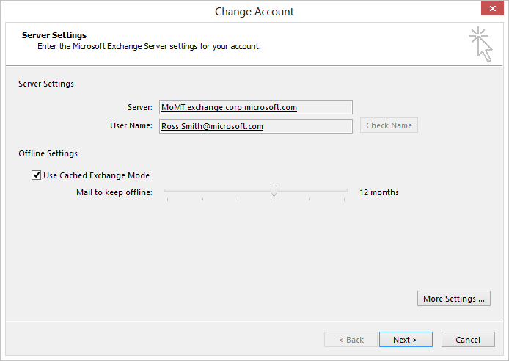
Large Mailboxes for the win!
Time | Items | Mailbox Size
1 Day | 150 | 11 MB
1 Month | 3300 | 242 MB
1 Year | 39000 | 2.8 GB
2 Years | 78000 | 5.6 GB
4 Years | 156000 | 11.2 GB
Large Mailbox Size 100GB+
Aggregate Mailbox = Primary Mailbox + Archive Mailbox + Recoverable Items
1-2 years of mail (minimum)
Increased knowledge worker productivity
Eliminate or reduce PST reliance
Eliminate or reduce third-party archive solutions
Outlook 2013 allows you to control OST size!
Gives more options around mailbox deployments
Notes:
*150 messages Sent/Received /Day, 75KB message size, no deletions, 5-day work week
Regarding OL2013: initial searches are done against the local cache. If the sync window is configured and there are more results to be found on the server, this will show up at the bottom of the results list. Clicking the “More” button will re-issue the search against the server. No searches will execute against the server by default, they’re only triggered by user action.

Slide 26
Exchange Search Infrastructure
Leverages Search Foundation
Common, actively developed search platform used across Office server products
Does consume more memory (1/6 available memory) to improve query performance
FAST Search
Provides
Significantly improved query performance compared to Exchange 2010
Significantly improved indexing performance compared to Exchange 2010
Feature parity with Exchange 2010 search
Leverages the same cmdlets like Get-MailboxDatabaseCopyStatus

Slide 27



Exchange Indexing
Reduced Processing of Body and Attachments
MBX 2013
MBX 2013
Transport
Transport
Content Transformation
Service
Mailbox
Mailbox
Local Delivery
Store
ExSearch
CTS
Index Node
Passive
DB
Idx
Reliable
Event
Read
Content
Log
DB
Idx
Log
Notes:
In E2007/E2010, Exchange would index message once they arrived in the store (and thus indexed each recipient’s copy). So if you take the example where a message has 3 recipients and lives within the store for 3 years, replicated to a total of 4 copies, with mailbox moves occurring twice a year, that would result in around 72 separate processing actions by the Indexing service!
In E2013, we have moved core index processing to transport. We will process a message before DL expansion, and annotate the message with the key words. The message will then get categorized and bifurcated and ultimately delivered to store. A notification event will trigger the Exchange index service to index the item (essentially consume the annotated word list) and get written to the FAST index.
Note that indexing is also done: (1) based on notifications from store (message deletions, edits, moves) and (2) during migration. If the annotation stream is missing (14 ==> 15 moves), we will wordbreak the content and annotate the message before it reaches the destination mailbox. As with transport processing, (2) amortizes the cost of indexing and reduces CPU spikiness.
In environments where databases are replicated, the Index on the passive will crawl the active copies to receive updates. However, in this case, we are just consuming the compressed word lists, as opposed to the entire message, thereby reducing WAN traffic.
CTS Flow in transport is executed before DL expansion
Words to index only and are stored on the message
An average message has 3 recipients
Lives up to 3 years
Mailbox is moved 2 times per year
Indexed on 4 copies
3*3*2*4 = 72
E14 processed the body and attachments up to 72 times
E2013 processes the body and attachments once!

Slide 28

Public Folders
Dawn of a New Age
Architectural bet
Public folders are based on the mailbox architecture
Details
Hierarchy is stored in PF mailboxes (one writeable)
Content can be broken up and placed in multiple mailboxes
The hierarchy folder points to the target content mailbox
Uses same HA mechanism as mailboxes
No separate replication mechanism
Single-master model
Similar administrative features to current PFs (setting quota, expiry, etc.)
No end-user changes (looks just like today’s PFs)
Not all public folder usage scenarios are best served by public folders
Private
logon
Public Logon
Public
logon
CAS 2013
Hierarchy Mailbox
Content Mailbox
MBX 2013
MBX 2013
MBX 2013
Notes:
Exchange Public Folder Guidance Blog Post: http://blogs.technet.com/b/exchange/archive/2008/03/31/3405234.aspx
New Whitepaper being released soon: Moving Public Folders to Office365 – Provides alternative to PFs since O365 does not currently have PFsok.
Scenario
Document Sharing - SharePoint is better option
Calendar Sharing - SharePoint if New to PFs, Either SharePoint or Exchange is existing PFs
Contact Sharing - SharePoint if New to PFs, Either SharePoint or Exchange is existing PFs
Discussion Forums - SharePoint if New to PFs, Either SharePoint or Exchange is existing PFs
Distribution Group Archive - SharePoint if New to PFs, Either SharePoint or Exchange is existing PFs
Custom Applications - SharePoint may be better option
Organizational Forms - Use InfoPath
Lacking information on Public Folders
Migrating is not a trivial process

Slide 29
Agenda
Exchange Server 2013
New Exchange Architecture
Client Access Server 2013
Mailbox Server 2013
Transport Architecture
Service Availability
Exchange and Office 365 – Hybrid
What is it good for?
Migration scenarios
Hybrid deployment
Migrations interfaces

Slide 30
Transport on Client Access Front-End Transport Service
Handles all inbound and outbound external SMTP traffic for the organization, as well as client endpoint for SMTP traffic
Does not replace the Edge Transport Server Role
Functions as a layer 7 proxy and has full access to protocol conversation
Will not queue mail locally and will be completely stateless
All outbound traffic appears to come from the CAS2013
Listens on TCP 25 and TCP 587 (two receive connectors)
Notes:
Does not terminate SMTP in perimeter
In E2013 FET is a proxy solution. Therefore all existing Edge agents which are based on OnEndOfData can’t be supported in FET.

Slide 31




Processing Inbound Messages
External Server
CAS
MBX
New SMTP Connection
CAS performs envelope filtering
CAS determines route to best MBX server
Message delivery begins
If successful, CAS returns 250 OK acknowledgement to external server
If unsuccessful, CAS returns 421 response

Slide 32
Benefits of SMTP Front-End Service
The SMTP Front-End Service provides:
Protocol level filtering – performs connection, recipient, sender and protocol filtering
Network protection – centralized, load balanced egress/ingress point for the organization
Mailbox locator – avoids unnecessary hops by determining the best MBX 2013 to deliver the message
Load balanced solution for client/application SMTP submissions
Scales based on number of connections – just add more servers
Notes:
Mailbox Locator. The SMTP FrontDoor will have knowledge to where in the Exchange organization the destination mailbox is located. Inbound SMTP conversations can be proxied to a Hub server that is located close to the mailbox location is, and not to a random Hub server.
If inbound traffic is directed at a Hub Server in the Exchange topology, that Hub server will act as an additional hop between the external source and the appropriate mailbox location.
FET is useful for our E2013 architecture:
1. It keeps with our proxy architecture around protocols (all things entering into the org must go through an CAS2013).
2. It enables customers to separate protocol filtering from content filtering (or choose to have multiple layers if they have third-party SMTP gateway solutions in the perimeter network).
3. It provides a central entry point for internal mail flow applications (e.g., SharePoint).
4. It provides a central entry point for IMAP/POP clients.
5. #3 and #4 solve the SMTP namespace related issues of not having FET and keeps with our model of not requiring commercially trusted certs on MBX2013.

Slide 33
Transport Components on Mailbox
Transport in MBX 2013 has been broken down into three components
Transport Service - Stateful and handles SMTP mail flow for the organization and performs content inspection (Was previously referred to as “Hub Transport”)
Mailbox Transport Delivery Service - Receives mail from the Transport service and deliveries to the Mailbox Database
Mailbox Transport Submission Service - Takes mail from the Mailbox Databases and submits to the Transport service
Mailbox Transport is stateless and does not have a persistent storage mechanism
Mailbox Transport performs content conversion
Notes:
Routing will now select the next hop for each recipient individually
Routing now recognizes DAG boundaries, in addition, to AD site boundaries
When delivering to Mailbox Transport, HT will queue per database and query Active Manager to determine which Mailbox Transport to connect to based on the active database location
When delivering to another HT, HT will queue per DAG and prefer closer HTs in the target DAG
Send/Delivery-Agent Connectors can be homed on entire E2013+ DAGs or individual Hubs; communicate through Front End for marked Send Connectors

Slide 34
Transport Components on Mailbox Responsibilities
Receives all inbound mail to the organization (Proxied through CAS or direct)
Submits all outbound mail from the organization (Proxied through CAS or direct)
Handles all internal message processing such as Transport Rules, Content Filtering, and Anti-Virus
Performs mail flow routing
Queue messages
Supports SMTP extensibility
Notes:
Routing will now select the next hop for each recipient individually
Routing now recognizes DAG boundaries, in addition, to AD site boundaries
When delivering to Mailbox Transport, HT will queue per database and query Active Manager to determine which Mailbox Transport to connect to based on the active database location
When delivering to another HT, HT will queue per DAG and prefer closer HTs in the target DAG
Send/Delivery-Agent Connectors can be homed on entire E2013+ DAGs or individual Hubs; communicate through Front End for marked Send Connectors

Slide 35
Routing Optimizations
Next hop selection is broken down into distinct delivery groups:
Routable DAG
Mailbox Delivery Group
Connector Source Servers
AD Site (Hub Sites; Edge Subscriptions)
Server list (DG expansion servers)
Queuing is per delivery group, connector, or mailbox
Once message is received at final destination, Transport will deliver the message via SMTP to Mailbox Transport on the server hosting the active database copy
Send/Delivery-Agent Connectors can have source servers from multiple DAGs or AD Sites, and can be proxied through CAS
Notes:
Routable DAG: This is a collection of Exchange 2013 Preview Mailbox servers that belong to one DAG. The mailbox databases in the DAG are the routing destinations that are serviced by this delivery group. After the message arrives at the Hub Transport service on a Mailbox server that belongs to the DAG, the Hub Transport service routes the message to the Mailbox Transport service on the Mailbox server in the DAG that currently holds the active copy of the destination mailbox database. The Mailbox Transport service on the destination Mailbox server then delivers the message to the local mailbox database. Although a DAG may contain Mailbox servers located in different Active Directory sites, the DAG is the delivery group boundary.
Mailbox delivery group: This is a collection of Exchange servers of the same version located in one Active Directory site. The Active Directory site is the delivery group boundary. The routing destinations and the delivery groups that service them are separated by the major release versions of Exchange in the Active Directory site. The mailbox databases located on Exchange 2010 Mailbox servers are serviced by the Exchange 2010 Hub Transport servers located in the Active Directory site. The mailbox databases located on Exchange 2013 Preview Mailbox servers in Active Directory site that don't belong to a DAG are serviced by the Hub Transport service on Exchange 2013 Preview Mailbox servers in the Active Directory site. How the message is delivered to the mailbox database depends on version of Exchange:
Exchange 2013 Preview: After the message arrives at the destination Mailbox server in the destination Active Directory site, the Hub Transport service uses SMTP to transfer the message to the Mailbox Transport service. The Mailbox Transport service then delivers the message to the local mailbox database using RPC.
Exchange 2010: After the message arrives at a random Exchange 2010 Hub Transport server in the destination Active Directory site, the store driver on the Hub Transport server uses RPC to write the message to the mailbox database.
Connector source servers: This is a mixed collection of Exchange 2010 Hub Transport servers or Exchange 2013 Preview Mailbox servers that are scoped as the source server for a Send connector, a Delivery Agent connector or a Foreign connector. The connector is the routing destination that's serviced by this routing group. When a connector is scoped to a specific server, only that server is allowed to route messages to destination defined by the connector. This delivery group may contain Exchange 2010 Hub Transport servers or Exchange 2013 Preview Mailbox servers located in different Active Directory sites.
AD site: In some circumstances, an Active Directory site isn't the ultimate destination of a message, but the message must pass through an Exchange 2010 Hub Transport server or Exchange 2013 Preview Mailbox server in that Active Directory site. Those circumstances include:
When the Active Directory site is configured as a hub site. When the hub site exists on the least-cost routing path for message delivery, the messages queue and are processed by a transport server in the hub site before they're relayed to their ultimate destination.
When an Exchange 2010 or Exchange 2007 Edge Transport server is subscribed to the Active Directory site. These subscribed Edge Transport servers aren't directly accessible from other Active Directory sites.
Note: Delayed fan-out is only used when the delivery group is an Active Directory site. Delayed fan-out attempts to reduce the number of message transmissions when multiple recipients share any part of the least-cost routing path.
Server list: This is a collection of one or more Exchange 2010 Hub Transport servers or Exchange 2013 Preview Mailbox servers that are configured as distribution group expansion servers. The distribution group expansion server is the routing destination serviced by this delivery group.

Slide 36


Mail Delivery
DAG
CAS / MBX
MBX-1
MBX-2
SMTP
SMTP
Transport
Transport
SMTP
Mailbox
Transport
Mailbox
Transport
MAPI
DB1
DB2
DB1
DB2
Notes:
Safety Net -> Enhanced Shadow Reduncy
Primary failure is identified by either unavailabke for a configurable time period (default 3 hours) or primary server acknowledges with a different mail.que database id
Different mail.que ID indiciate a failure of the primary queue database that held the original email, so possibly did not deliver the email correctly.
Shadow heartbeat interval 2 minutes by default

Slide 37
Agenda
Exchange Server 2013
New Exchange Architecture
Client Access Server 2013
Mailbox Server 2013
Transport Architecture
Service Availability
Exchange and Office 365 – Hybrid
What is it good for?
Migration scenarios
Hybrid deployment
Migrations interfaces
Notes:
Who runs Exchange 2013 already?
Who maintains an Exchange 2010 environment?
Mixed with Exchange 2007?
Mixed with Exchange 2003?
Who maintains even Exchange older than 2003?
Anybody who already deployed an hybrid configuration or migrated to Office 365?

Slide 38
Service Availability Improvements
Best copy selection now includes health of services when selecting best copy
Failover time reductions
Lagged copy enhancements
Simpler site resilience strategy
Managed Availability

Slide 39
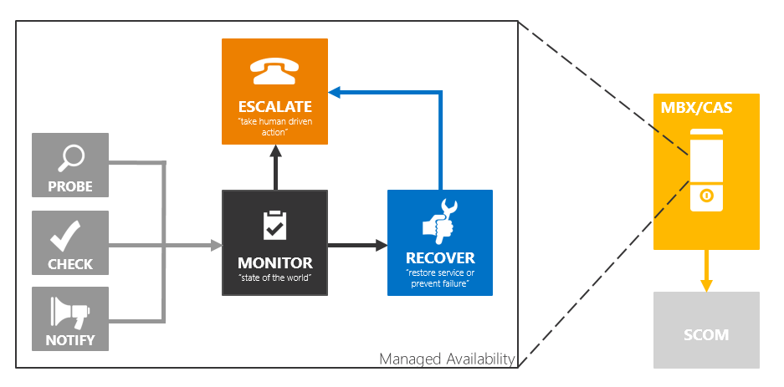
Managed Availability
Monitoring and recovery infrastructure is integrated with Exchange’s high availability solution
Detects and recovers from problems as they occur and are discovered
Is user focused – if you can’t measure it, you cannot monitor it
Notes:
Internal monitoring and HA are tied together and can be used to detect and recover from problems as they occur and are discovered
It’s user focused. We want to measure three key aspects – the availability, the experience, which for most client protocols is measured as latency, and whether errors occur. So the way to think about is from an availability perspective, can the user access the service? If they cannot access it, then the solution is immediately broken and you will get a help desk escalation. It’s similar to going to the grocery store - is it opened or closed? If they can get in, what is their experience like? It’s like getting to the check-out counter at a grocery store and waiting in line forever. Naturally that is a bad experience. But let’s assume you have no line, or the line is really fast, do you have any issues with the register? If you do, then that is a bad experience as well.
In E2010, we had alerts that attempted to deliver root cause. We are not doing that in E2013. We are doing the opposite. We were never effective at communicating root cause in previous releases. Sometimes we were right, sometimes we were wrong. So we aren’t communicating root cause in the monitoring system. This doesn’t mean the data isn’t recorded in the logs, or dumps generated. It’s just that monitoring won’t deliver root cause.

Slide 40
Managed Availability
Managed Availability + Retries…“stuff breaks and the Experience does not”
LB
CAS-1
DAG
OWA send
OWA failure
OWA failure detected
OWA restart service
OWA restart complete
OWA verified as healthy
OWA send
OWA failure
OWA failure detected
OWA restart service
OWA restart service failed
Failover server’s databases
OWA service restarts
OWA verified as healthy
Server becomes “good” failover target (again)
MBX-1
DB1
DB2
DB1
OWA
OWA
OWA
OWA
MBX-2
DB1
DB2
DB1
OWA
CAS-2
MBX-3
DB1
DB2
OWA

Slide 41
Transport High Availability Improvements
Every message is redundantly persisted before its receipt is acknowledged to the sender
Delivered messages are kept redundant in transport similar to active messages
Every DAG represents a transport HA boundary and owns its HA implementation
If you have a stretched DAG, you also have transport site resilience
Resubmits due to transport DB loss or MDB *over are fully automatic and do not require any manual involvement
Notes:
Every message is redundantly persisted before its receipt is acknowledged to the sender (where the sender can be an external MTA, a user mailbox, an Exchange server of a different version and so on). The primary goal of Transport HA is to prevent message loss due to various outages. Making messages redundant before acknowledging their receipt eliminates the E14 Shadow Redundancy dependency on multiple hops and protocol extensions and eliminates the need for Delayed ACK for HA-unaware senders. For mailbox submissions, this tenet eliminates reliance on the “sent items copy in mailbox” – that dependency is also unreliable because in Wave 15 the mailbox may be co-located with the Hub Transport that processes the message.
Basically this works by redundantly persisting a copy of the message elsewhere in the DAG prior issuing a response to the DATA verb.
Every DAG represents a Transport HA boundary and owns it’s HA implementation. This tenet scopes down the number of servers that can possibly hold a redundant copy of a given message and makes resubmits more manageable. This also provides for a simple versioning story where future versions can have different HA implementation without any back-port requirements. And the fact that Mailbox Store and Transport end up with the same HA boundary is a big plus.
Delivered messages (Dumpster/SafetyNet) are kept redundant in transport similar to active messages. As stated before, Hub Transport may be co-located with the Mailbox Store it delivers a given message to, so transport has to maintain redundant copies of dumpster messages in case the entire server goes down. The Safety Net keeps messages over a long period of time and having a single copy makes it likely that some data will be missing due to a prior outage when a Safety Net resubmit is requested.
Resubmits due to Transport DB loss or MDB failover are fully automatic and do not require any manual involvement.

Slide 42
Summary
New Building Blocks
Facilitates deployments at all scales – from self-hosted small organizations to Office 365
Provides more flexibility in namespace management
Simplified HA
All core Exchange functionality for a given mailbox is served by the MBX 2013 server where that mailbox’s database is currently activated
Simplifies the network layer
Transport protection is built-in
Simplified upgrade and inter-op
All components in a given server upgraded together
No need to juggle with CAS <-> MBX versions separately
Aligned with hardware trends
Utilize CPU core increase, cheaper RAM
Utilize capacity effectively
Fewer disks/server => simpler server SKUs

Slide 43
Summary – Part II
What is gone
Exchange Management Console and Exchange Control Panel
RPC/TCP access for Outlook clients
Support for Outlook 2003
OWA built-In spell-check (now relies on Browser)
Linked connectors
Forefront Protection for Exchange
What is (currently) not available
S/MIME support in Outlook Web App
Public Folder support on Outlook Web App
What is different
No uninstall option for CUs
Larger disk space requirements -> 30GB minimum (mostly due to Safety Net and Managed Availability logging)
Notes:
Tools
Exchange Best Practice Analyzer
In Exchange 2010, the Exchange Best Practice Analyzer examined your Exchange deployment and determined whether the configuration was in line with Microsoft best practices. In Exchange 2013, the Exchange Best Practice Analyzer has been retired.
Mail flow troubleshooter
In Exchange 2010, the mail flow troubleshooter assisted you in troubleshooting common mail flow problems. In Exchange 2013, the mail flow troubleshooter has been retired. You can now use the messaging tracking feature in EAC in Exchange 2013. For more information, see Track Messages with Delivery Reports.
Performance monitor
In Exchange 2010, the Performance Monitor was included in the Exchange toolbox to allow you to collect information about the performance of your messaging system. Performance Monitor is commonly used to view key parameters while troubleshooting performance problems. In Exchange 2013, the Performance Monitor has been retired from the toolbox. You can still find the Performance Monitor under Administrative Tools in Windows Server 2008.
Performance troubleshooter
In Exchange 2010, the Performance Troubleshooter helped you to locate and identify performance-related issues that could affect an Exchange server. In Exchange 2013, the Performance Troubleshooter has been retired from the toolbox.
Routing Log Viewer
In Exchange 2010, you could use the Routing Log Viewer to open a routing log file that contained information about the routing topology. The tool consisted of a parser and a public user interface. In Exchange 2013, the routing log viewer has been retired.

Slide 44

Questions

Slide 45
Agenda
Exchange Server 2013
New Exchange Architecture
Client Access Server 2013
Mailbox Server 2013
Transport Architecture
Service Availability
Exchange and Office 365 – Hybrid
What is it good for?
Migration scenarios
Hybrid deployment
Migrations interfaces
Notes:
Who runs Exchange 2013 already?
Who maintains an Exchange 2010 environment?
Mixed with Exchange 2007?
Mixed with Exchange 2003?
Who maintains even Exchange older than 2003?
Anybody who already deployed an hybrid configuration or migrated to Office 365?

Slide 46
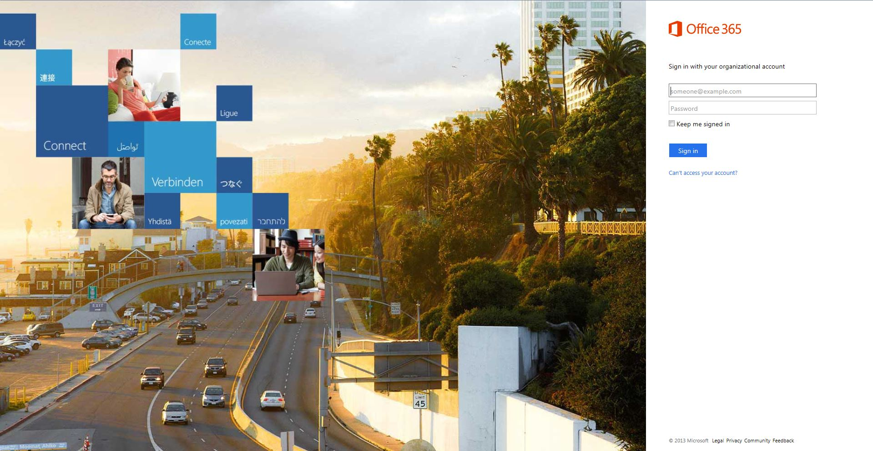

Slide 47
What is it good for?
Enhance service availability for messaging
Mobile work force
Small / remote branch offices
Reduce on-premise hardware costs
HA implementations are still expensive
Online archiving
Avoid on-premise message archiving infrastructure
Because we can and it is new cool stuff

Slide 48
Benefits and risks
Benefits
Risks
Enterprise security and reliability
Numerous layers of security at Office 365 data centers
Stringent privacy policies
99.9 percent uptime
IT control and efficiency
Security updates and back-end systems upgrades handled by Office 365
On-premise IT staff uses browser and PowerShell to manage tenant
User familiarity and productivity
Easy transitioning for employees
Always on experience
Contracts
Current contracts with UC vendors might interfere with new UC deployments
Regulations
Might not be suitable to certain laws an regulations (e.g. PCI)
Customization
Limited SharePoint and Exchange customization features available
Notes:
Benefits:
SMBs benefit from enterprise infrastructure at SMB prices
It staff has control over user management and service configurations
Easy to use from any laptop, PC or Smartphone, depending on WiFi capability or phone network availability
Risks:
Are you contractually bound to another competitive service or product, such as collaborative communications from Cisco or a conference call bridge provider? Your current contracts with Unified Communication solutions might avoid the deployment of Lync solutions.
Office 365 covers many of the major regulations (such as HIPAA , ISO 27001 and FIRPA). Also, agencies with private or public data, such as governments outside the USA, need to understand the data may be routed or stored through the United States and may be applicable under the US Patriot Act. You should discuss this one with an expert (and your law team) to understand your risk before jumping in.

Slide 49
Migration options
IMAP migration
Supports wide range of email platforms
Email only (no calendar, contacts, or tasks)
Cutover Exchange migration (CEM)
Good for fast, cutover migrations
No migration tool or computer required on-premises
Staged Exchange migration (SEM)
No migration tool or computer required on-premises
Requires Directory Synchronization with on-premises AD
 | IMAP migration | Cutover migration | Staged migration | 2010 hybrid | 2013 hybrid
Exchange 5.5 | ■
Exchange 2000 | ■
Exchange 2003 | ■ | ■ | ■ | ■
Exchange 2007 | ■ | ■ | ■ | ■ | ■
Exchange 2010 | ■ | ■ |  | ■ | ■
Exchange 2013 | ■ | ■ |  |  | ■
Notes/Domino | ■
GroupWise | ■
Other | ■
Simple migrations
Hybrid deployment
Manage users on-premises and online
Enables cross-premises calendaring, smooth migration, and easy off-boarding
Hybrid
Additional options available with tools from migration partners
Notes:
Here is a summary of the migration tools and options we have with Exchange Online. Customers have choices to move to the cloud quickly with native migration options, to take a more measured approach to the cloud according to their business requirements or maintaining mailboxes on-premises and online for a longer period of time.
Note: Exchange 2013 hybrid does not work with Exchange 2003. However, Exchange 2003 customers will be able to deploy Exchange 2010 hybrid with Exchange Online 15 in order to have a smoother experience to migrate to the cloud if other options are not ideal for their business requirements. (more details in the hybrid deployment section later in the module)

Slide 50
Additional onboarding options
Control | Deployment Type | Description
User driven | New mailbox | User receives new “green field” mailbox – i.e. user is onboarded to without data migration.
 | New mailbox + Outlook PST | User receives new mailbox and either attaches or imports PST files for access to pre-Office 365 data.
 | New mailbox + connected accounts | User receives new mailbox and configures connected accounts via OWA.
Admin driven | New mailbox + PST Import | User receives a new mailbox and admin uses the PST Capture Tool to import PST data into the user’s Exchange Online mailbox.
Notes:
These are “non-migration” options for onboarding to Exchange Online.
This options are not discussed further in this module other than for awareness here.
Additional information about Connected Accounts http://help.outlook.com/en-us/140/dd181953.aspx
Additional information about the PST Capture Tool http://technet.microsoft.com/en-us/library/hh781036.aspx

Slide 51

Migration option decision factors
Coexistence
requirement
Provisioning
Size
Simple
Rich
DirSync
Manual/Bulk Provisioning
Automatic Provisioning
Large
Medium
Small
Source server
Identity management
DEPLOYMENT PLAN
Migration solution is part of the plan
Exchange
IMAP
Lotus Notes
Google
On-premises
Single sign-on
On-cloud
51 | Microsoft Confidential
Notes:
Source server, organization size, and coexistence requirements are factors in choosing a migration option.
The provisioning method is often dictated by the option chosen (e.g. Cutover does not support DirSync while Staged and Hybrid require DirSync).
Identity management is part of a deployment plan but does not affect the choice of a migration solution.

Slide 52
DirSync
Enables coexistence
Provisions objects in Office 365 with same email addresses as the objects in the on-premises environment
Provides a unified Global Address List experience between on-premises and Office 365
Objects hidden from the GAL on-premises are also hidden from the GAL in Office 365
Enables coexistence for Exchange
Works in both simple and hybrid deployment scenarios
Enabler for mail routing between on-premises and Office 365 with a shared domain namespace
Notes:
DirSync’s role in migrations

Slide 53
Simple coexistence deployment
Uses Directory Synchronization for GAL synchronization
Enabler for mail routing between on-premises and Office 365 using a shared DNS namespace
Provides a unified GAL experience
Can be used with cloud identities or federated identities
Does not require an on-premises Hybrid server
Notes:
This slide explains the role of DirSync in a simple coexistence deployment.

Slide 54
Hybrid deployment
Uses Directory Synchronization for GAL synchronization
Enabler for mail routing between on-premises and Office 365 using a shared DNS namespace
Provides a unified GAL experience
Can be used with cloud identities or federated identities

Slide 55
Hybrid deployment
Attribute | Feature
SafeSendersHash BlockedSendersHash SafeRecipientHash | Safelist Aggregation (a.k.a. Filtering Coexistence ) enables on-premises filtering using cloud safe/blocked sender info
msExchArchiveStatus | Cloud Archive Allows users to archive mail to the Office 365 service
ProxyAddresses (cloudLegDN) | Mailbox off-boarding Enables off-boarding of mailboxes back to on-premises
cloudmsExchUCVoiceMailSettings | Voicemail Co-Existence Used for Exchange Unified Messaging-Microsoft Lync Server 2010 integration to indicate to on-premises Lync Server that the user has voice mail in the cloud
Enables DirSync “Write Back”
Easily move mailboxes back to on-premises (off-boarding)
Enables Safelist Aggregation (a.k.a. Filtering Coexistence)
Enables cloud archive
Requires on-premises hybrid server deployment

Slide 56
Agenda
Exchange Server 2013
New Exchange Architectur
Client Access Server 2013
Mailbox Server 2013
Transport Architecture
Service Availability
Exchange and Office 365 – Hybrid
What is it good for?
Migration scenarios
Hybrid deployment
Migrations interfaces
Notes:
Who runs Exchange 2013 already?
Who maintains an Exchange 2010 environment?
Mixed with Exchange 2007?
Mixed with Exchange 2003?
Who maintains even Exchange older than 2003?
Anybody who already deployed an hybrid configuration or migrated to Office 365?

Slide 57
IMAP features and benefits
Works with a large number of source mail systems
Works with on-premises or hosted systems
Users can be migrated in batches
On-premises migration tool is not required
Notes:
http://help.outlook.com/en-us/140/ms.exch.ecp.emailmigrationwizardimaplearnmore.aspx

Slide 58
IMAP requirements and limitations
Access to IMAP ports (TCP/143/993)
SMTP domains configured in Office 365 tenant
Users + mailboxes must be provisioned prior to migration
Bulk provisioning, CSV parser, manual, etc.
Gather user credentials or setup admin credentials
Prepare a CSV file with list of users
Email address, user name, password
Max of 50,000 rows
Very limited data migration scope

Slide 59
IMAP data migration scope
Migrated
Mail messages (Inbox and other folders)
Maximum of 500,000 items
Possible to exclude specific folders from migration (e.g. Deleted Items, Junk E-Mail)
Not migrated
Contacts, Calendars, Tasks, etc.
Excluded folders
Folders with a forward slash ( / ) in the folder name
Messages larger than 35 MB

Slide 60




IMAP migration flow
Provision
users
+
mailboxes
in O365
(license assigned)
Gather IMAP credentials and prepare CSV
EAC
Wizard:
Enter server settings and upload CSV
Initial
sync
Change MX
record
Mark migration as complete
Final
sync and cleanup
Delta
sync
every 24 hours

Slide 61
CEM features and benefits
Simple and quick migration solution
High-fidelity solution – all mailbox content is migrated
Typically best suited to small and medium organizations
Users are provisioned automatically during migration
Works with Exchange 2003 and newer
Works with on-premises or hosted Exchange systems
Identity management in the cloud (at least initially)
On-premises migration tool is not required

Slide 62
CEM requirements and limitations
Outlook Anywhere service on source system (must have SSL certificate issued by a public CA)
Migration Account with Full Access or Receive-As permissions to all mailboxes that will be migrated
SMTP domains configured in Office 365 tenant
Directory Sync tool disabled in Office 365 tenant
Up to 1000 mailboxes in source system
Notes:
Detects the configuration of directory sync in the Office 365 tenant:
- If DirSync is disabled, cutover migration is the option
- If DirSync is enabled, staged migration is the option

Slide 63
CEM architecture
On-premises Exchange org
Office 365
Users, Groups, Contacts via Outlook Anywhere (NSPI)
Mailbox Data via Outlook Anywhere (RPC over HTTP)
Exchange 2003 or later

Slide 64
CEM accounts and passwords
Accounts provisioning
Migration tool creates users, mailboxes, DLs and contacts
Migration enables replies to migrated messages (i.e. provision process brings over the Legacy DNs)
Passwords
No access to passwords from source directory
New passwords created for all users
A link to download passwords is sent to admin
Users must change password on their first login
Notes:
CEM performs its own provisioning of mailboxes, DLs and contacts.
NSPI or the Name Service Provider Interface (http://msdn.microsoft.com/en-us/library/hh354767(v=EXCHG.80).aspx) protocol provides a way for messaging clients to access and manipulate address data that is stored by a server. This protocol enables the client to use a single RPC interface and several interface methods to manipulate Address Book object data stored on the server.
Only reads some attributes from directory.
Brings over legacy DNs and other SMTP proxy addresses to maintain replyability.

Slide 65
CEM data migration scope
Migrated
Mail messages and folders
Rules and categories
Calendar (normal, recurring)
Out-of-Office settings
Contacts
Tasks
Delegates and folder perms
Outlook settings (e.g. favorites)
Not migrated
Security Groups, DDLs
System mailboxes
Dumpster
Send-As permissions
Messages larger than 25 MB

Slide 66
CEM data migration scope
Partial migrations are not possible (no folder exclusion, no time range selection, etc.)
Mailboxes enabled for Unified Messaging cannot be migrated
Hidden mailboxes (not visible to tool) cannot be migrated
New cloud mailbox is created (new GUID) and data is copied
Existing cached-mode files (OST files) cannot be preserved

Slide 67
CEM user experience
Admin needs to distribute new passwords to users
Users create their new Outlook profile using Office 365 username and new passwords (Autodiscover)
All mail is downloaded from the Office 365 mailbox (i.e. the OST file must be recreated)

Slide 68


CEM migration flow
Configure Outlook anywhere
Test using ExRCA
Assign migration
permissions
EAC
Wizard:
Enter server settings and admin
credentials
Migration
tool
provisions
users mailboxes
DLs
contacts
in O365
Initial
sync
Change MX
record
Mark migration as complete
Final
sync and cleanup
License users
Delta
sync
every 24 hours

Slide 69
SEM features and benefits
Simple and flexible migration solution
High-fidelity solution – all mailbox content is migrated
Typically best suited to medium and large organizations
Users are provisioned with Directory Sync prior to migration
No limit on the number of mailboxes
Users can be migrated in batches (up to 1000 per batch)
Works with Exchange 2003 and 2007 only, on-premises or hosted
Identity management on-premises
On-premises migration tool is not required

Slide 70
SEM requirements
Outlook Anywhere service on source system (must have SSL certificate issued by a public CA)
Migration Account with Full Access or Receive-As permissions to all mailboxes that will be migrated
SMTP domain(s) configured in Office 365 tenant
Directory Sync tool enabled in Office 365 tenant (i.e. requires simple coexistence)
Notes:
Detects the configuration of directory sync in the Office 365 tenant:
- If DirSync is disabled, cutover migration is the option
- If DirSync is enabled, staged migration is the option

Slide 71
SEM limitations
SEM is not supported with Exchange 2010 and 2013
Only simple coexistence is available (no sharing of free/busy, calendar, etc.)
Notes:
A feature of SEM is the setting the targetAddress on the source mailbox to ensure coexistence mail flow. This is done via the NPSI protocol. There was a security enhancement in Exchange 2010 and 2013 that makes NPSI read-only. Thus, Exchange 2010/2013 are not supported by SEM.
NSPI or the Name Service Provider Interface (http://msdn.microsoft.com/en-us/library/hh354767(v=EXCHG.80).aspx) protocol provides a way for messaging clients to access and manipulate address data that is stored by a server. This protocol enables the client to use a single RPC interface and several interface methods to manipulate Address Book object data stored on the server.

Slide 72

SEM architecture
On-premises Exchange org
Office 365
Users, Groups, Contacts via DirSync
Office 365 Directory Synchronization
app
Mailbox Data via Outlook Anywhere (RPC over HTTP)
Exchange 2003 or 2007
Notes:
Directory Sync is used to provision objects in Office 365
Outlook Anywhere connection (RPC over HTTP) is used to migrate data

Slide 73


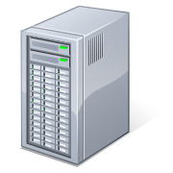

Mail routing Pre-coexistence
On-premises
MX Record:
contoso.com
Active Directory
Exchange
User Object
Mailbox-enabled
ProxyAddresses: SMTP: John.Doe@contoso.com
Message filtering
Notes:
Mail routing before deploying Office 365
Could apply to Notes, GroupWise, Exchange, etc.
Animation Walkthrough
Internet user sends a message to “John Doe”
Follows MX record for contoso.com
Exchange performs a query for a matching SMTP address
Finds the object with the matching SMTP address
Message is delivered to the mailbox
Everyone is, most likely, very familiar with this scenario

Slide 74


Mail routing On-premises to Office 365
On-premises
Office 365
MX Record:
contoso.com
Active Directory
Exchange
Exchange Online
Online Directory
User Object
Mail-enabled (not mailbox-enabled)
ProxyAddresses: SMTP: John.Doe@contoso.com
TargetAddresses: SMTP: John.Doe@contoso.mail.onmicrosoft.com
Message filtering
Exchange Online Protection
Logon Enabled User
Mailbox-enabled
ProxyAddresses: SMTP: John.Doe@contoso.com
smtp: John.Doe@contoso.onmicrosoft.com
smtp: John.Doe@contoso.mail.onmicrosoft.com
MX Record:
contoso.onmicrosoft.com
contoso.mail.onmicrosoft.com
DirSync
DirSync Web Service
Notes:
Message routing via on-premises to an Office 365 mailbox
Emphasize the importance of understanding mail routing while in coexistence
Principles of mail routing applies to simple and hybrid deployment scenarios
Animation Walkthrough - Part 1: From Internet
Starts out with the same on-premises mail platform, design, and message flow as the pre-coexistence slide
Customer now has an Office 365 subscription which provides a coexistence domain (contoso.mail.onmicrosoft.com) when DirSync is enabled on the tenant
Customer has already implemented DirSync and has synchronized “John Doe” to Office 365
Important Note: “John Doe” has also been migrated to Office 365 and is using the Office 365 mailbox which means that mail forwarding is setup in the on-premises environment to forward messages to Office 365 via a mail-enabled user object and corresponding target address that uses the coexistence domain
Internet user sends a message to “John Doe”
Follows MX record for contoso.com
Exchange performs a query for a matching SMTP address
Finds the object with the matching SMTP address and sees that there is also a target address
Message is then forwarded the target address
Follows MX record for contoso.mail.onmicrosoft.com to Exchange Online server
Exchange performs a query for a matching SMTP address
Finds the object with the matching SMTP address
Message is delivered to the mailbox
Animation Walkthrough - Part 2: From Coworker
“Jane Doe” (who has not been migrated and still exists on-premises) sends a message to “John Doe”
Exchange performs a query for a matching SMTP address
Finds the object with the matching SMTP address and sees that there is also a target address
Message is then forwarded to the target address
Follows MX record for contoso.mail.onmicrosoft.com to Exchange Online server
Exchange performs a query for a matching SMTP address
Finds the object with the matching SMTP address
Message is delivered to the mailbox

Slide 75
Mail routing Office 365 to on-premises
On-premises
Office 365
MX Record:
contoso.com
Active Directory
Exchange
Exchange Online
Online Directory
User Object
Mailbox-enabled
ProxyAddresses: SMTP: Jane.Doe@contoso.com
Logon Enabled User
Mail-enabled (not mailbox-enabled)
ProxyAddresses: SMTP: Jane.Doe@contoso.com
smtp: Jane.Doe@contoso.onmicrosoft.com
smtp: Jane.Doe@contoso.mail.onmicrosoft.com
TargetAddresses: SMTP: Jane.Doe@contoso.com
Message filtering
Exchange Online Protection
MX Record:
contoso.onmicrosoft.com
contoso.mail.onmicrosoft.com
DirSync
DirSync Web Service
Notes:
Message routing from Office 365 to on-premises
Emphasize the importance of understanding mail routing while in coexistence
Principles of mail routing applies to simple and hybrid deployment scenarios
Animation Walkthrough
Same on-premises mail platform, design, and message flow and Office 365 subscription
Customer has already implemented DirSync and has synchronized “Jane Doe” to Office 365
Important Note: “Jane Doe” has not been migrated to Office 365 – only synchronized. Message forwarding is automatically setup in the Office 365 environment to forward messages to on-premises via a mail-enabled user object whose target address matches the primary SMTP address.
A coworker that already exists in Office 365 (could be “John Doe” again) sends a message to “Jane Doe”
Exchange performs a query for a matching SMTP address
Finds the object with the matching SMTP address and sees that there is also a target address
targetAddress is the same as primary SMTP address, but Exchange will route the message out of the Exchange Online organization because of the fact that the targetAddress has a value (default Exchange behavior)
Message is then forwarded the target address
Follows MX record for contoso.com to on-premises server
Exchange performs a query for a matching SMTP address
Finds the object with the matching SMTP address
Message is delivered to the mailbox

Slide 76
SEM accounts and passwords
Accounts provisioning
Migration tool relies on DirSync to do provisioning
For every on-premises mailbox to be migrated there needs to be a Mail enabled user (MEU) or Mailbox in Office 365
Passwords
Target mailbox passwords must be specified for all users
Administrators can force users to change passwords on first login
Notes:
Passwords are specified in batch CSV file
Force password change flag is also in batch CSV file

Slide 77
SEM batch file format
CSV format
Email address, password, force change password
One user per line
Max of 1000 users in each CSV
Smart-check against the Office 365 directory
Notes:
Before starting migration batch, migration tool validates that each user named in the CSV file exist in tenant as a mail-enabled user (MEU). If not found, error message is displayed so that migration administrator can correct problem before submitting the batch for migration.
Password is the password that will be set on the new cloud-based mailbox. Any password restrictions that are applied to your cloud-based organization apply to the passwords included in the CSV file. This attribute is optional. If using SSO, leave this blank.
If using SSO, the value of the ForceChangePassword must be set to False.

Slide 78
SEM data migration scope
Migrated
Mail messages and folders
Rules and categories
Calendar (normal, recurring)
Out-of-Office settings
Contacts
Tasks
Delegates and folder perms
Outlook settings (e.g. favorites)
Not migrated
Security Groups, DDLs
System mailboxes
Dumpster
Send-As permissions
Messages larger than 25 MB
Notes:
Same data as CEM (same migration engine)

Slide 79
SEM data migration scope
Partial migrations are not possible (no folder exclusion, no time range selection, etc.)
Mailboxes enabled for unified messaging cannot be migrated
Hidden mailboxes (not visible to tool) cannot be migrated
New cloud mailbox is created (new GUID) and data is copied
Existing cached-mode files (OST files) cannot be preserved
Notes:
UM must be disabled on source mailboxes and then enabled on the cloud mailbox after migration.
The mailbox “hide from GAL” flag must be cleared so that the migration tool can see the mailbox.

Slide 80
SEM user experience
Admin needs to distribute new passwords to users
Users create their new Outlook profile using O365 username and new passwords (Autodiscover)
All mail is downloaded from the Office 365 mailbox (i.e. the OST file must be recreated)

Slide 81
SEM migration flow
Configure Outlook anywhere
Test using ExRCA
Assign migration
permissions
Configure Directory
Sync
EAC
Wizard:
Enter server settings, admin
credentials, batch CSV
Migrate Batch
Convert on-prem mailboxes to MEU
Delete migration batch
(optional)
License users
Change MX
record
Notes:
Repeat 4 middle steps until all users are migrated, then change MX record.
More details about converting MBX to MEU and scripts: Exchange 2003: http://community.office365.com/en-us/wikis/exchange/834.aspx Exchange 2007: http://community.office365.com/en-us/wikis/exchange/845.aspx

Slide 82
Agenda
Exchange Server 2013
New Exchange Architecture
Client Access Server 2013
Mailbox Server 2013
Transport Architecture
Service Availability
Exchange and Office 365 – Hybrid
What is it good for?
Migration scenarios
Hybrid deployment
Migrations interfaces
Notes:
Who runs Exchange 2013 already?
Who maintains an Exchange 2010 environment?
Mixed with Exchange 2007?
Mixed with Exchange 2003?
Who maintains even Exchange older than 2003?
Anybody who already deployed an hybrid configuration or migrated to Office 365?

Slide 83
Hybrid key features and benefits
Federation trust
Delegated authentication for on-premises/cloud web services
Integrated admin experience
Manage all of your Exchange functions, whether cloud or on-premises from the same place - Exchange Administration Center (EAC)
Native mailbox move
Online mailbox moves
Preserve the Outlook profile and offline file (OST)
Secure mail flow
Authenticated and encrypted mail flow
Preserves the internal Exchange messages headers
Support for compliance mail flow scenarios (central transport)
Enables Free/Busy, calendar sharing, message tracking, online archive, and more
Leverages the Mailbox Replication Service (MRS)

Slide 84
Hybrid coexistence feature comparison
Feature | Simple | Hybrid
Mail routing between on-premises and cloud (recipients on either side) | ■ | ■
Mail routing with shared namespace (if desired) on both sides | ■ | ■
Unified GAL | ■ | ■
Free/Busy and calendar sharing cross-premises |  | ■
Out of Office understands that cross-premises is “internal” to the organization |  | ■
Mailtips, messaging tracking, and mailbox search work cross-premises |  | ■
OWA redirection cross-premise (single OWA URL for both on-premises and cloud) |  | ■
Single tool to manage cross-premises Exchange functions (including migrations) |  | ■
Mailbox moves support both onboarding and offboarding |  | ■
No outlook reconfiguration or OST resync required after mailbox migration |  | ■
Preserve auth header (ensure internal email is not spam, resolve against GAL, etc.) |  | ■
Centralized mail flow , ensures that all email routes inbound/outbound via on-prem |  | ■
Notes:
This is what you get when you have Hybrid coexistence.
Some features are optional and require more configuration than others.

Slide 85
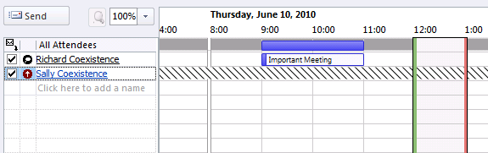
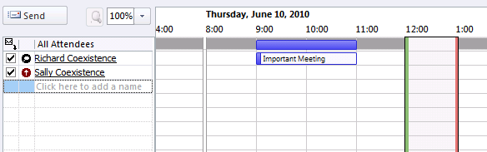
Hybrid coexistence feature example
Cross-premises free/busy and calendar sharing
Creates the look and feel of a single, seamless organization for meeting scheduling and management of calendars
Works with any supported Outlook client
Notes:
Nobody wants shaded rows when preparing meeting requests

Slide 86
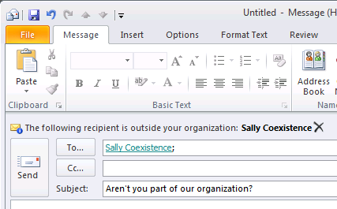
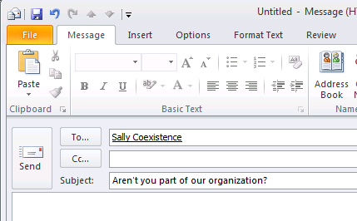
Hybrid coexistence feature example
Cross-premises MailTips
Correct evaluation of “Internal” vs. “External” organization context
Allows awareness and correct Outlook representation of MailTips
Notes:
Who uses mail tips currently?

Slide 87
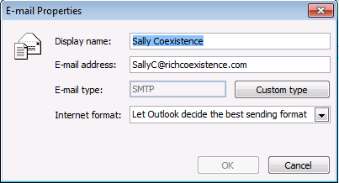
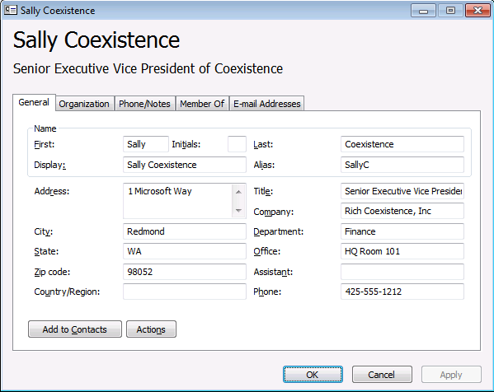
Hybrid coexistence feature example
Cross-premises mail flow
Preserves internal organizational headers (e.g. auth header)
Message is considered “trusted” and resolve the sender to rich recipient information in the GAL (not SMTP address)
Restrictions specified for that recipient are honored

Slide 88
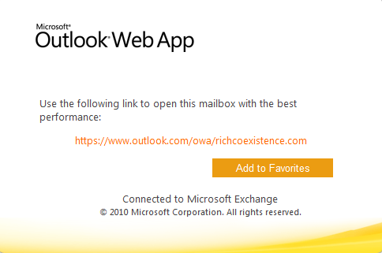
Hybrid coexistence feature example
Single OWA URL
Ensures a good end-user experience as mailboxes are moved in-and-out of the cloud since OWA URL remains unchanged (points to on-premises “hybrid” CAS)
Log in experience can be improved by adding domain name into your cloud URL so that you can access your cloud mailbox without the interruption of Go There page

Slide 89
Hybrid features and benefits summary
Makes your on-premises organization and cloud organization work together like a single, seamless organization
Offers near-parity of features/experience on-premises and in the cloud
Seamless interactions between on-premises and cloud mailboxes
Migrations in and out of the cloud transparent to end-user

Slide 90
2013 hybrid requirements
Exchange 2013 CAS/MBX server on-premises
Hybrid configuration in place
On-premises config, Office 365 config, federation using Microsoft Federation Gateway (MFG), certificates, etc.
Much of the config is automated by the Hybrid Configuration Wizard
SMTP domain(s) configured in Office 365 tenant
Directory Sync tool enabled in Office 365 tenant
Active Directory Federation Services (AD FS) in place
Can be utilized for any cloud based service which uses federated identities, i.e. SAP ByDesign
Notes:
MFG

Slide 91
2013 hybrid limitations
Exchange 2003 is not supported
Delegation coexistence cross-premises (delegate permissions are migrated when users are in the same batch)
Migration of Send As/Full Access permissions
Notes:
Note that Exchange 2013 hybrid no longer supports Exchange 2003
Customers who have Exchange 2003 can still use Exchange 2010 hybrid
Exchange 2010 hybrid will be able to connect to an O15 tenant once Exchange 2010 SP3 comes out
SP3 in 1st half of 2013 per this EHLO blog entry: http://blogs.technet.com/b/exchange/archive/2012/09/25/announcing-exchange-2010-service-pack-3.aspx

Slide 92
Hybrid user experience
If configured for SSO (AD FS), users login with their AD credentials. Otherwise, admin needs to distribute new password to user.
User’s current Outlook profile is updated with the Exchange Online server name via Autodiscover.
Offline files (OST files) do not have to be recreated.
If using Outlook at the time of the mailbox move, user is prompted to close and reopen Outlook.
Notes:
Mailbox moves from Exchange 2003 are offline moves. The mailbox is locked for the duration of the move. Exchange 2003 is only supported by an Exchange 2010 based hybrid deployment.
Mailbox moves from Exchange 2007 and 2010 are online moves. User can continue to use mailbox during the move. Once the move is completed, the user is prompted to closer and reopen Outlook.

Slide 93

Hybrid user experience Autodiscover
On-premises systems
Office 365
Remote Mailbox
Primary SMTP address:
user@contoso.com
Remote Routing address:
user@contoso.mail.onmicrosoft.com
Mailbox
Primary SMTP address:
user@contoso.com
Secondary SMTP address:
user@contoso.mail.onmicrosoft.com
AD
Forest
Exchange 2013 CAS
Exchange Online
Outlook attempts to discover endpoint through DNS record “autodiscover.contoso.mail.onmicrosoft.com”
Where is my mailbox?
Local Exchange passes a redirect to “contoso.mail.onmicrosoft.com”
Request authentication
Authentication success
Mailbox server information
Outlook profile updated.
OST rebuild not required!

Slide 94
2013 Hybrid Improvements 1/2
Adaptive Hybrid Configuration Wizard (HCW) HCW adapts to individual setup requirements and presents only necessary questions. Automatically gathers information whenever possible.
Integrated support for Edge HCW supports configuring Exch2010 Edge Transport servers directly within the wizard.
Enhanced secure mail Simpler to configure and no longer dependent on static IP addresses in the connector configuration.
Notes:
More information in these EHLO blogs: http://blogs.technet.com/b/exchange/archive/2012/09/20/the-cloud-on-your-terms-part-i-deploying-hybrid.aspx http://blogs.technet.com/b/exchange/archive/2012/09/20/the-cloud-on-your-terms-part-ii-managing-hybrid.aspx

Slide 95
2013 Hybrid Improvements 2/2
Flexible EOP connection and internet mail routing Support for updating MX and directing all inbound internet mail to EOP at any stage of the hybrid deployment – before, during or after hybrid configuration.
Improved centralized mail transport Added flexibility and capability – centralized mail transport is supported even when pointing MX to EOP.
Integrated mailbox migration and move wizard One wizard regardless of scenario – hybrid, staged, cutover, or IMAP.
Notes:
More information in these EHLO blogs: http://blogs.technet.com/b/exchange/archive/2012/09/20/the-cloud-on-your-terms-part-i-deploying-hybrid.aspx http://blogs.technet.com/b/exchange/archive/2012/09/20/the-cloud-on-your-terms-part-ii-managing-hybrid.aspx

Slide 96
2013 hybrid high-level architecture
On-premises Exchange org
Office 365
Office 365 Directory Synchronization
app
Users, Groups, Contacts via DirSync
Secure Mail Flow
Sharing (free/busy, MailTips, archive, etc.)
Mailbox Data via MRS
Existing Exchange 2007 or later
Exchange 2013 CAS and MBX

Slide 97








Exchange 2013 hybrid deployment
Clients
Office 365
1. Prepare
Install Exchange SP and/or updates across the ORG Prepare AD with E2013 CU1 schema
autodiscover.contoso.com
mail.contoso.com
5
Autodiscover & EWS
2. Deploy Exchange 2013 servers
Install both E2013 MBX and CAS servers with CU1
Set an ExternalUrl for the Exchange Web Services vdir
SMTP
4
1
2
3. Obtain and deploy certificates
Obtain and deploy certificates on E2013 MBX and CAS servers
Exchange 2010 or 2007 servers
E2010 or 2007 Hub
E2010 or 2007 CAS
3
E2013 CAS
SP/RU
4. Publish protocols externally
Create public DNS A records for the EWS and SMTP endpoints
Validate using Remote Connectivity Analyzer
SP/RU
Intranet site
6
5. Switch autodiscover namespace to E2013 CAS
Change the public autodiscover DNS record to resolve to E2013 CAS
E2010 or 2007 MBX
7
E2013 MBX
6. Run the Hybrid Configuration Wizard
7. Move mailboxes
Internet facing site
Notes:
from an existing Exchange 2007 or 2010 environment—no Edge Transport server
E2007 rollup (SP3 RU8+?) and E2010 (SP3)
Note that E2013 MBX is required (in E2013 transport service runs on MBX server)
Cert on E2013 CAS for Autodiscover and on E2013 MBX server for secure mail flow (sending) to O365

Slide 98
2013 hybrid deployment flow
Clients
Office 365
1. Prepare
Install Exchange SP and/or updates across the ORG Prepare AD with E2013 CU1 schema
autodiscover.contoso.com
mail.contoso.com
Autodiscover & EWS
2. Deploy Exchange 2013 servers
Install both E2013 MBX and CAS servers with CU1
Install E2010 EDGE servers
Set an ExternalUrl for the Exchange Web Services vdir
5
SMTP
1
2
4
Exchange 2010 or 2007 servers
3. Obtain and deploy certificates
Obtain and deploy certificates on E2013 MBX and CAS servers & E2010 EDGE servers
E2010 or 2007 Hub
E2010 or 2007 CAS
3
E2013 CAS
E2010 EDGE
SP/RU
SP/RU
4. Publish protocols externally
Create public DNS A records for the EWS and SMTP endpoints
Validate using Remote Connectivity Analyzer
Intranet site
6
5. Switch autodiscover namespace to E2013 CAS
Change the public autodiscover DNS record to resolve to E2013 CAS
E2010 or 2007 MBX
7
E2013 MBX
6. Run the Hybrid Configuration Wizard
Internet facing site
7. Move mailboxes
Notes:
From an existing Exchange 2007 or 2010 environment—with Edge Transport server
E2007 rollup (SP3 RU8+?) and E2010 SP1 (SP3)
Note that E2013 MBX is required (in E2013 transport service runs on MBX server)
Cert on E2013 CAS for Autodiscover and on E2013 MBX server for secure mail flow (sending) to O365

Slide 99
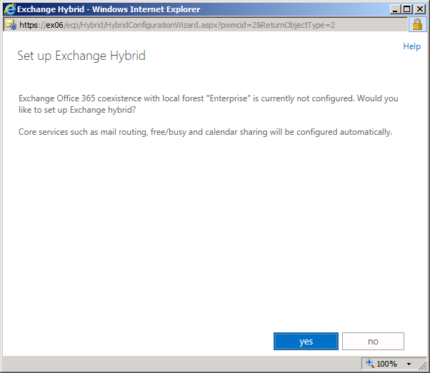
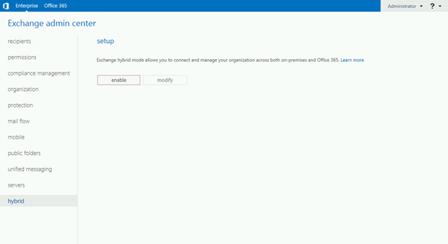
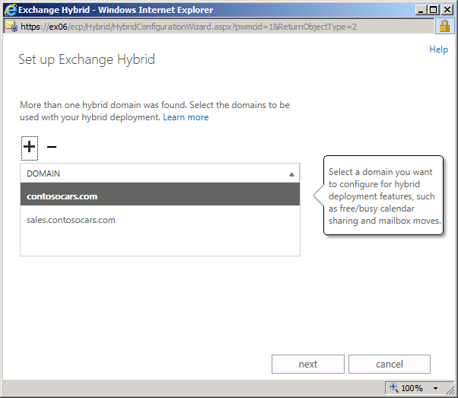
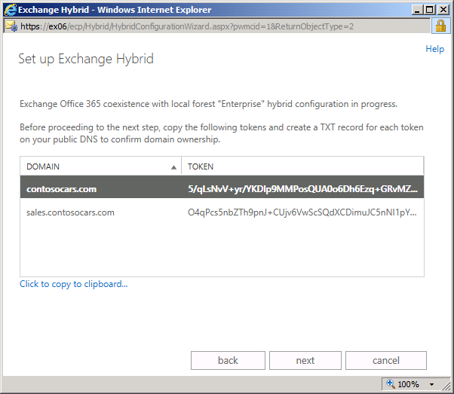
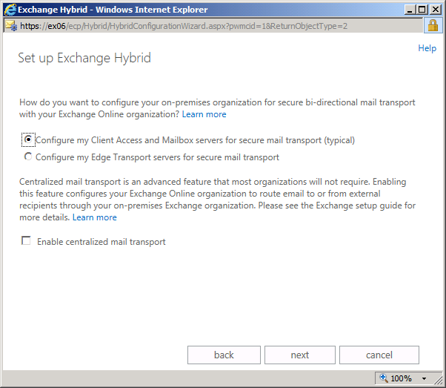
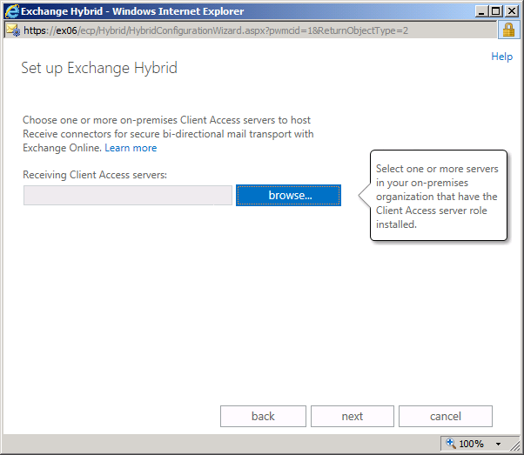

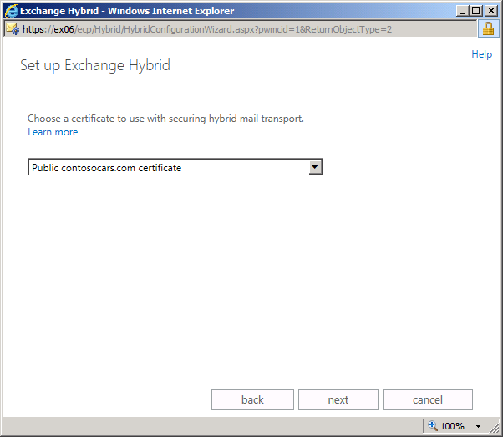
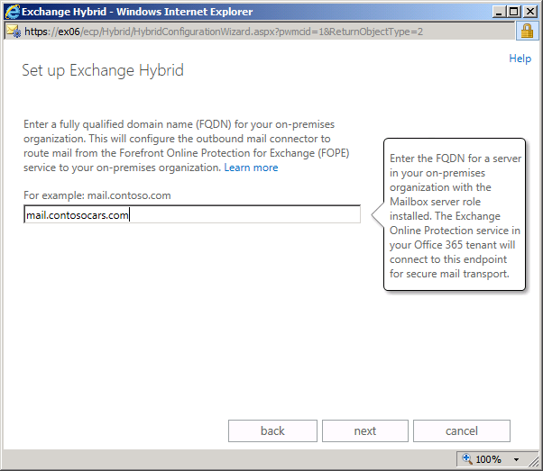
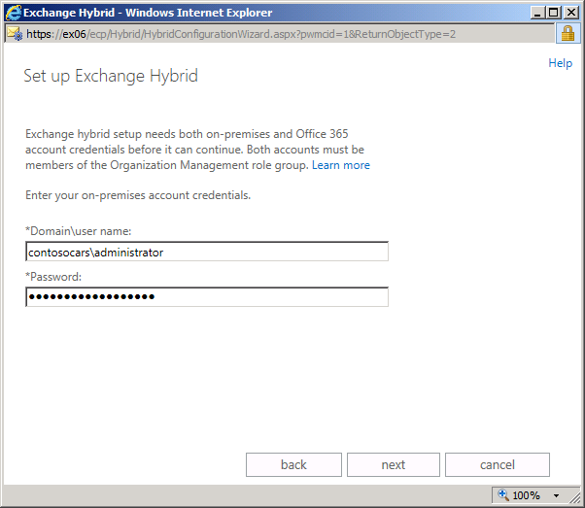
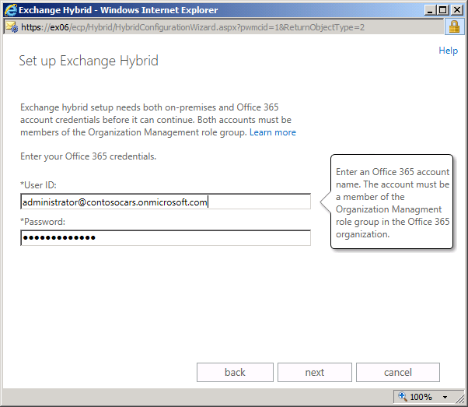
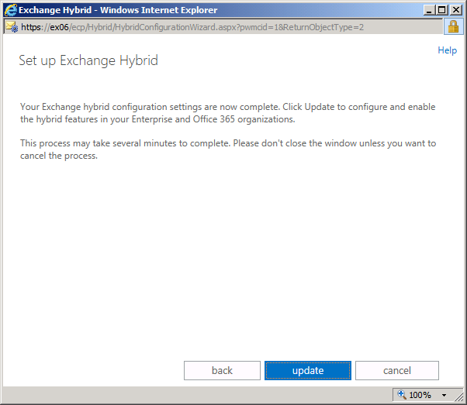
Hybrid configuration wizard
Start HWC from EAC
Confirm running the wizard
Select hybrid domain*
View/Copy domain proof token*
Choose transport options
Choose receive 2013 CAS server(s)
Choose send 2013 MBX server(s)
Select transport certificate
Enter external FQDN 2013 CAS
Enter Org Management AD account
Enter Global Admin O365 account
Choose Update to configure hybrid
* Adaptive steps
Notes:
EAC user interface has significant changes.
Requirements and sequence of tasks is very similar to Exchange 2010 SP2.
Step 3 is adaptive – question is not asked if tenant has a single verified domain.
Step 4 is adaptive – question is not asked if the domain has already been federated.

Slide 100
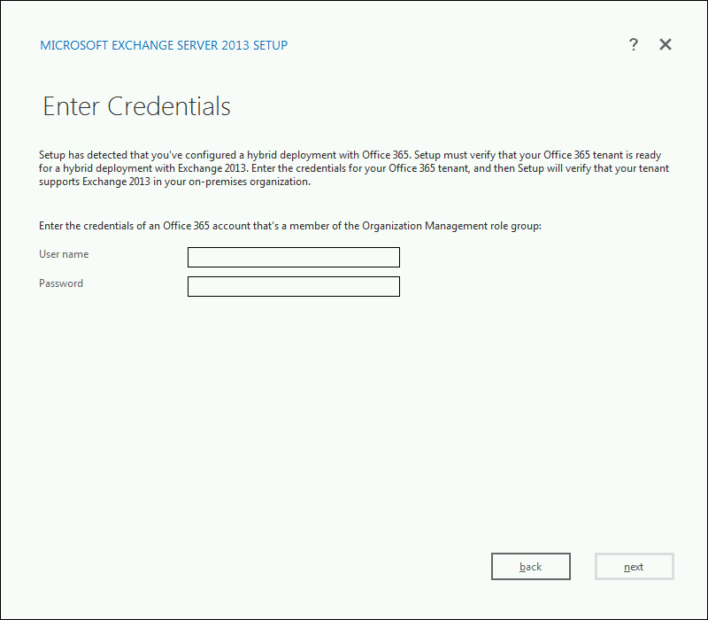
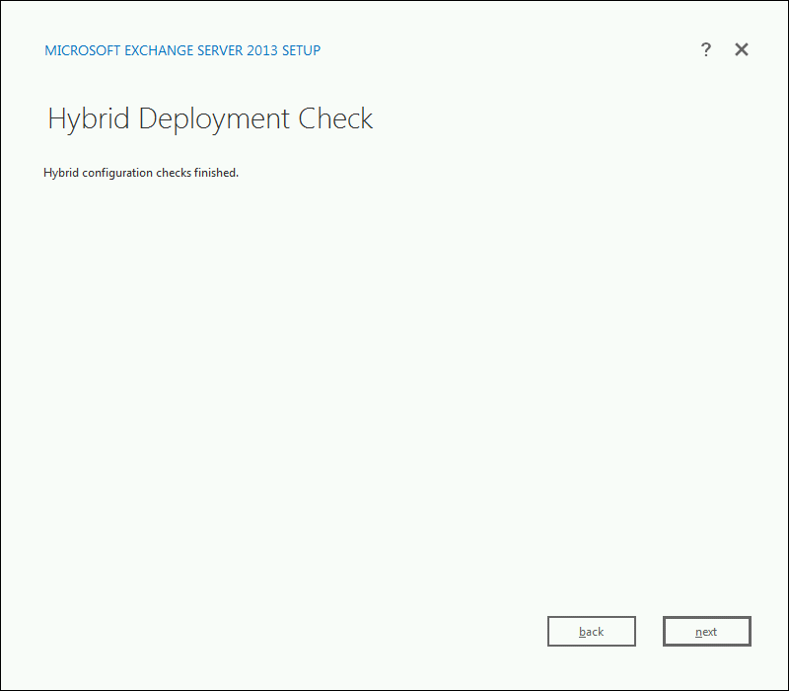
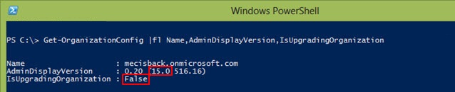
Hybrid coexistence feature example
Exchange 2013 is only supported against the next version of O365 tenant
Current O365 tenants must be fully upgraded to be compatible with Exchange 2013 on-premises
Exchange 2013 Setup and HCW include a tenant version check
Notes:
Test #1 – version 15 or above
Test #2 – has been fully upgraded
The setup check occurs once during the PrepareAD phase

Slide 101
Exchange 2010 hybrid support
Exchange 2010 SP3 will be compatible with current and new Office 365 tenants
Exchange 2010 based hybrid deployments will continue to support Exchange 2003 coexistence with the new Office 365 tenants
Once the new Office 365 service is launched, Exchange 2013 based hybrid is recommended for all new deployments (unless migrating from Exchange 2003)

Slide 102
Migration matrix
On-premises environment | Exchange 2010-based hybrid with tenant version v14 | Exchange 2010-based hybrid with tenant version v15 | Exchange 2013-based hybrid with tenant version v15
Exchange 2013 (CU1) | Not supported¹ | Not applicable | Supported
Exchange 2010 SP3 | Supported | Supported | Supported⁵
Exchange 2010 SP2 | Supported | Not supported² | Not supported
Exchange 2010 SP1 | Supported | Not supported² | Not supported
Exchange 2007 SP3 RU10 | Supported³ | Supported⁴ | Supported⁵
Exchange 2007 SP3 | Supported³ | Not Supported | Not supported
Exchange 2003 SP2 | Supported³ | Supported⁴ | Not supported
¹ Blocked in Exchange 2013 setup ² Tenant upgrade notification provided in Exchange Management Console ³ Requires at least one on-premise Exchange 2010 SP2 server | ⁴ Requires at least one on-premise Exchange 2010 SP2 server ⁵ Requires at least one on-premise Exchange 2013 (CU1) server
Notes:
http://technet.microsoft.com/en-us/library/jj945383

Slide 103
Agenda
Exchange Server 2013
New Exchange Architecture
Client Access Server 2013
Mailbox Server 2013
Transport Architecture
Service Availability
Exchange and Office 365 – Hybrid
What is it good for?
Migration scenarios
Hybrid deployment
Migrations interfaces
Notes:
Who runs Exchange 2013 already?
Who maintains an Exchange 2010 environment?
Mixed with Exchange 2007?
Mixed with Exchange 2003?
Who maintains even Exchange older than 2003?
Anybody who already deployed an hybrid configuration or migrated to Office 365?

Slide 104
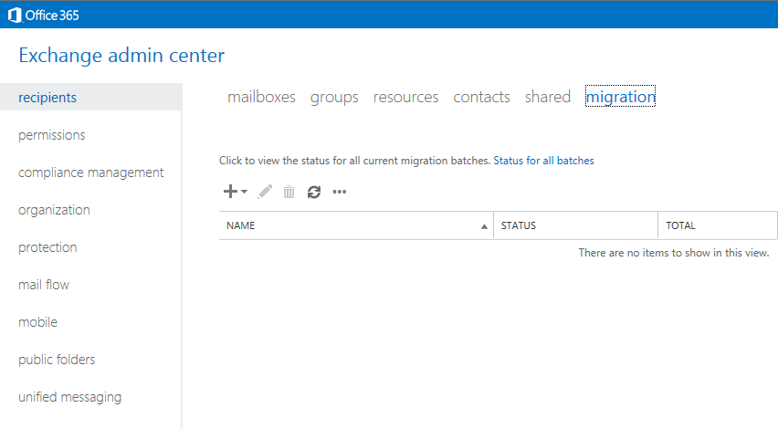
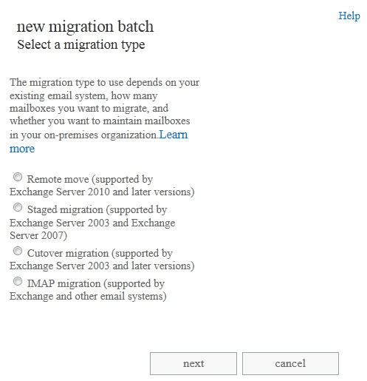
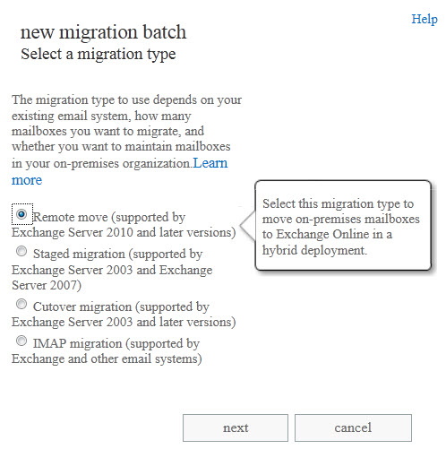
Migration interfaces EAC
In EAC, select
recipients | migration
Start migration wizard
Choose migration type and follow prompts
Choose hybrid remote move and follow prompts

Slide 105
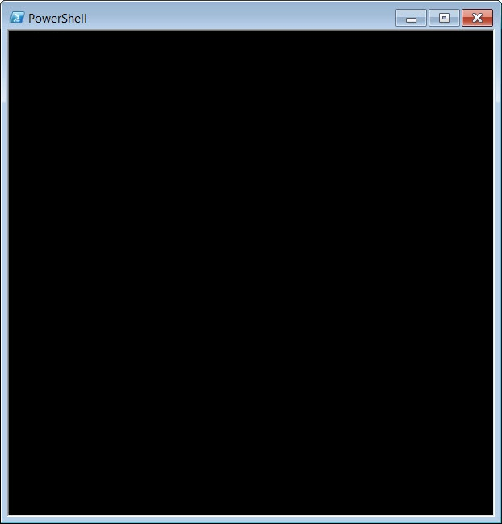
Migration interfaces PowerShell
Set of Migration Cmdlets
> New-MigrationBatch
> Start-MigrationBatch
> Get-MigrationBatch
> Get-MigrationStatus
> Complete-Migration
> Test-MigrationServerAvailability
New!
> Get-MigrationBatch -Diagnostic
Set of Hybrid Move Cmdlets
> New-MoveRequest
> Get-MoveRequest
> Get-MoveRequestStatistics
> Suspend-MoveRequest
> Resume-MoveRequest
> Remove-MoveRequest
Diaginostic switch improves troubleshooting
Migration Batch cmdlets can also start a hybrid move
Hybrid move cmdlets continue to be available
Notes:
These are the PowerShell cmdlets used with migrations.
“MigrationBatch” cmdlets can now also be used with hybrid mailbox moves.
“MoveRequest” cmdlets continue to work with hybrid mailbox moves.

Slide 106
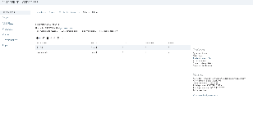
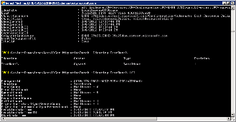

Migration architecture
Office 365
Data injection
Batch management
Retry (manual and automatic)
Source throttling
Protocol agnostic (onboarding)
Tenant fairness
Reporting
EAC
MigrationBatch
Migration Service
PowerShell
MigrationBatch
MRS
MRS
MoveRequest
Hybrid data move
Server level throttling
On-premises Exchange org
Notes:
Scenario #1 – Simple migration via EAC
Scenario #2 – Hybrid move via EAC
Scenario #3 – Simple migration via PowerShell
Scenario #4 – Hybrid move via PowerShell

Slide 107
Questions

Slide 108
Additional Resources – Exchange Architecture
Exchange Server 2013
Exchange Server 2013 for IT Pros http://bit.ly/18pQwlP
What's New in Exchange 2013 http://bit.ly/12bGzUq
Exchange 2013 Prerequisites http://bit.ly/15kTB7V
Exchange 2013 System Requirements http://bit.ly/128s8l8
What's New in Exchange 2013 Hybrid Deployments http://bit.ly/15kTObq
Microsoft Exchange Server Deployment Assistant http://bit.ly/10CqHqV
Prepare Active Directory and Domains http://bit.ly/18pRrma
Database Availability Groups http://bit.ly/13n9TJf
Federated sharing http://bit.ly/10hyAYR
Blackberry Enterprise Server and Exchange 2013 http://bit.ly/10k57J4

Slide 109
Additional Resources – Hybrid Deployments
Migrations
Hybrid deployments
Compare Migration Types http://bit.ly/10jLrEZ
Cutover Exchange Migrations http://bit.ly/Yqctxb
Staged Exchange Migrations http://bit.ly/18NWXwp
IMAP Migrations http://bit.ly/13cYqg0
Exchange team blog
Introduction to Hybrid http://bit.ly/128pGLu
Deploying Hybrid (Exchange 2013) http://bit.ly/13n4nGm
Managing Hybrid (Exchange 2013) http://bit.ly/11c6UpX
Decommissioning On-premise servers http://bit.ly/10jNJnJ

Slide 110
Additional Resources – Hybrid Deployments
Tools
Exchange remote connectivity analyzer http://www.exrca.com
Exchange client network bandwidth calculator http://bit.ly/10hsgR4
PST Capture Tool 2.0 http://bit.ly/Yqbyg5
PowerShell Deployment Scripts - Office 365 http://bit.ly/16NQLrC http://bit.ly/10htgok
Glen's Exchange Dev Blog – Powershell and EWS http://bit.ly/10hEYzg
Manage Your Organization - Office 365 for Enterprises http://bit.ly/10em9Hu
Manage Your Organization - Office 365 for Professionals and Small Businesses http://bit.ly/10jMDs6

Slide 111


Maintain a copy of the message in the queue database but don’t acknowledge the DATA verb
Generate a shadow copy on another MBX2013 server in the DAG (remote site preferred)
Wait for acknowledgement from the shadow server
Send acknowledgement to SMTP client
Delete message from queue after SafetyNet threshold has expired
Transport HA
CAS2013 or MBX2013
250 OK
SMTP
R1, R2, R3
250 OK
MBX1
MBX2
MBX3
MBX4
Transport
Transport
Transport
Transport
R1
R3
R1, R2, R3
R2
Mail.que
Mail.que
Mail.que
Mail.que
MBX Transport
MBX Transport
MBX Transport
MBX Transport
Store
Store
Site Boundary
Store
Store
DB1
DB2
Log
DB1
Log
DB2
DB1
Log
DB2
Log
DB1
Log
DB2
Log
250 OK
MBX5
MBX6
MBX7
MBX8
Transport
Transport
Transport
Transport
R3
R3
Mail.que
Mail.que
Mail.que
Mail.que
MBX Transport
MBX Transport
MBX Transport
MBX Transport
Store
Store
Store
Store
DB3
DB4
DB3
Log
DB4
DB3
Log
DB4
DB3
Log
DB4
Notes:
When a Hub receives a message over SMTP from a MTA/Client, before it’s response to the DATA/BDAT command it redundantly persist the message by doing the following:-
Maintain a copy of the message in its Queue database with all recipients marked as Active
Establish a shadow SMTP session with another Hub server in the same DAG; if a DAG spans multiple sites, a Hub in a different site is preferred (for site resiliency).
Transmit the message envelope and data to the shadow server
Wait for DATA/BDAT response from the shadow Hub server, indicating that the shadow copy of the message has been persisted in its Queue database (with all recipients marked as Shadow)
Send the response to DATA/BDAT command back to the sending MTA/Client
It’s important to note that we’re initiating shadowing of the message even before the receiving hub gets to use the XSHADOW command with the shadow server.

